Slide 1
Evidence for the Theory of Evolution

Slide 2
Syllabus
Syllabus:
Life has existed on Earth for approximately 3.5 billion years and has changed and diversified over time
State how long life has existed on Earth and how it has changed and diversified over time
What is the ‘theory of evolution’?
Essential
Question:

Slide 3
What you need to complete
BIOLOGY WA UNITS 3&4
READ
Chapter 8 Mechanisms of Evolution and Speciation
Questions
Set 8.1 pg.250 Q 1-5
BIOZONE
See slides for activity numbers

Slide 4
Important Exam Hint
As you take your notes on Evidence for Evolution make sure you include specific examples.
As you revise the Evidence for Evolution always include specific examples

Slide 5
Topic Question 1: define the terms, evolution, ancestor, common ancestor & theory
Evolution is the process of cumulative, heritable change in a population over many generations.
An ancestor is a species from which other species have evolved
A common ancestor refers to an ancestor that is shared by different species. This is supported by molecular evidence: there is a common genetic code in the form of DNA and RNA.
A theory is an explanation that has not been proven as fact using Scientific Method but is supported by evidence.

Slide 6
Topic Question 2: What does Darwin’s Theory of Evolution state?
Evolution is the slow & gradual change in genetic makeup of a population in successive generations over time
Variation exists within a species including variation in their phenotype & genotype. Some variations offer an advantage
As a result of natural selection these favoured traits are selected for
Gradually over many generations there will be a change in the allele frequency in the population with an increase in the frequency of the favoured alleles/traits

Slide 7
Topic Question 3: Why is the ‘theory of evolution’ a ‘theory’
In everyday use, the word "theory" often means an untested hunch, or a guess without supporting evidence
But for scientists, a theory has nearly the opposite meaning.
A theory is a well-substantiated explanation of an aspect of the natural world that can incorporate laws, hypotheses and facts.
The theory of gravitation, for instance, explains why apples fall from trees and astronauts float in space.
Similarly, the theory of evolution explains why so many plants and animals—some very similar and some very different—exist on Earth now and in the past, as revealed by the fossil record
https://www.amnh.org/exhibitions/darwin/evolution-today/what-is-a-theory
Notes:
A theory not only explains known facts; it also allows scientists to make predictions of what they should observe if a theory is true. Scientific theories are testable. New evidence should be compatible with a theory. If it isn't, the theory is refined or rejected. The longer the central elements of a theory hold—the more observations it predicts, the more tests it passes, the more facts it explains—the stronger the theory.
Many advances in science—the development of genetics after Darwin's death, for example—have greatly enhanced evolutionary thinking. Yet even with these new advances, the theory of evolution still persists today, much as Darwin first described it, and is universally accepted by scientists.

Slide 8
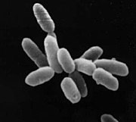
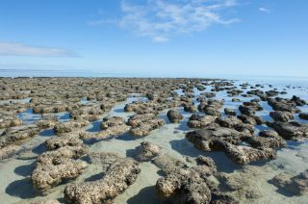
Topic Question 4: How long has life existed on earth?
First known life forms on Earth were a type of anaerobic bacteria that evolved approximately 3.5 billion years ago
Notes:
Stromatolites, like those found in the World Heritage Area of Shark Bay, Western Australia, may contain cyanobacteria, which were most likely Earth's first photosynthetic organisms.

Slide 9
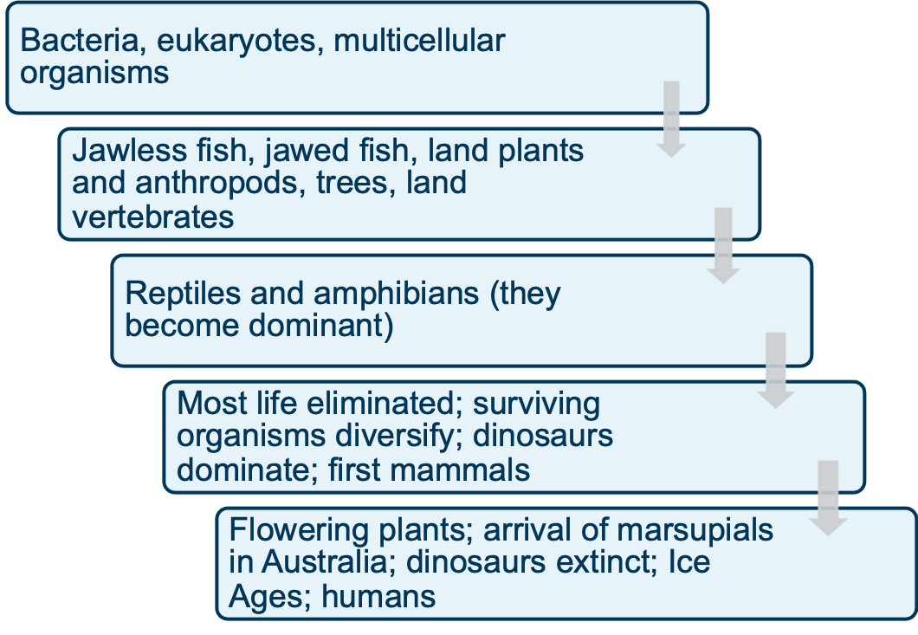
Topic Question 5: How has life changed and diversified on earth?
3.5 billon years ago

Slide 10
Topic Question 6: What is the geological time scale and what changes on Earth have occurred during this time?
Life has existed on Earth for approximately 3.5 billion years and has changed and diversified over time.
Continents, oceans and mountain ranges have moved vast distances both vertically and horizontally during this time

Slide 11
Topic Question 4: What is the geological time scale and what changes on Earth have occurred during this time?
Scientists use a geological time scale within which they can place major changes that have occurred in the history of Earth & life
Geological time scale has different sections based on the forms of life present and is based on the geological rock record (erosion, mountain formation & other geological events)
Video: https://www.youtube.com/watch?v=rWp5ZpJAIAE
https://australianmuseum.net.au/learn/australia-over-time/evolving-landscape/the-geological-time-scale/

Slide 12
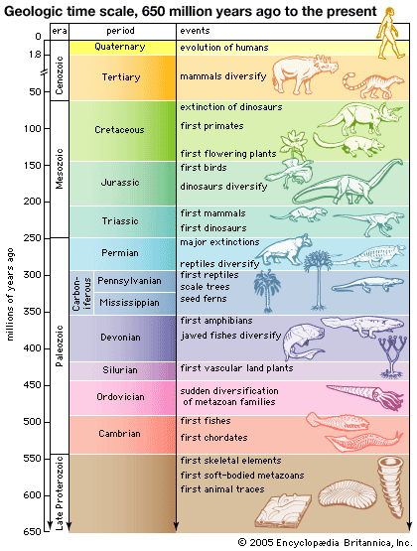

Slide 13
Topic Question 4: What is the geological time scale and what changes on Earth have occurred during this time?
Evolution has occurred over very vast stretches of time.
Time has been divided into segments called periods, eras, epochs and eons.
Geologic time can be expressed in millions of years ago (mya).

Slide 14
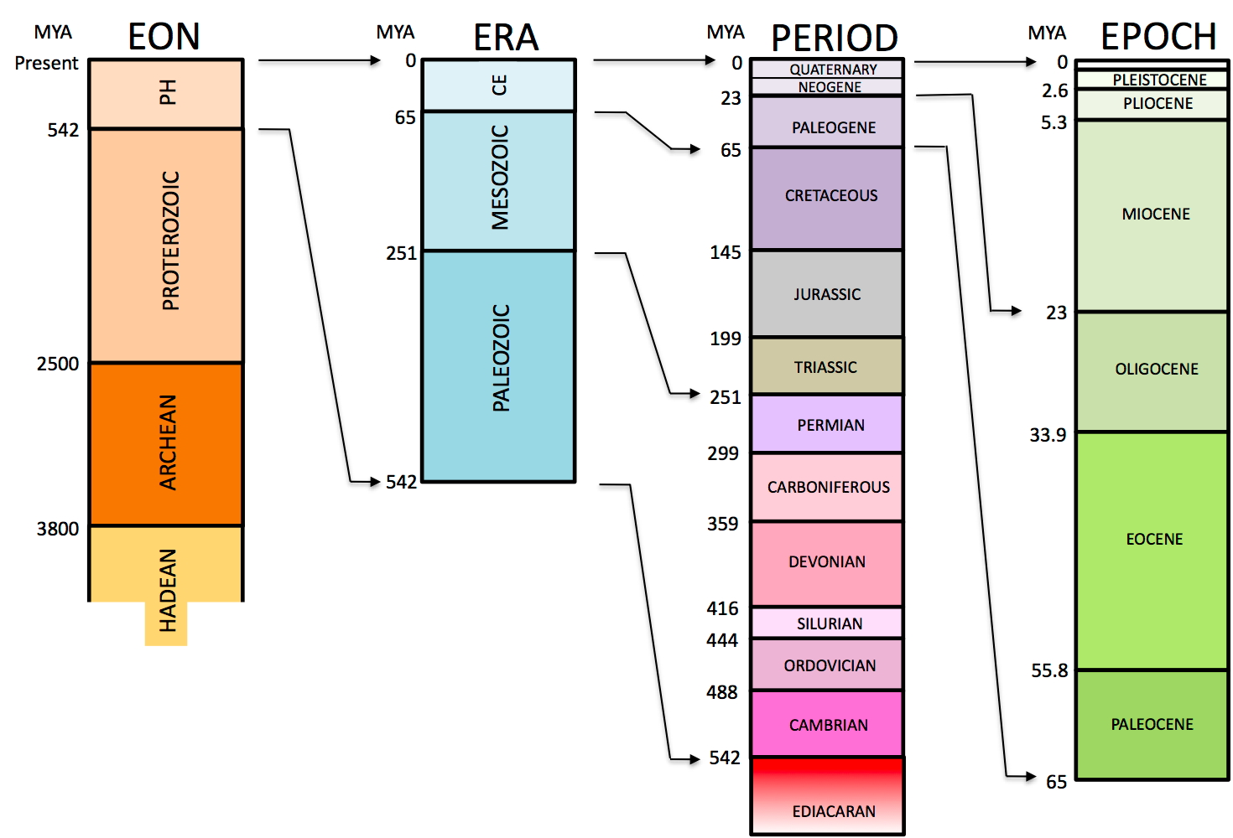

Slide 15
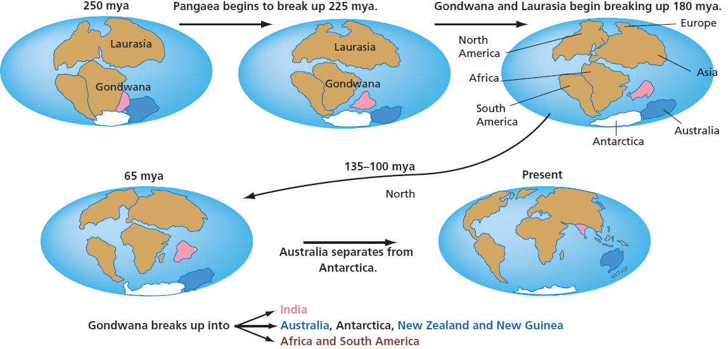
Topic Question 4: What is the geological time scale and what changes on Earth have occurred during this time?
Over time, the tectonic plates have moved significantly in a process called continental drift. The fossil record can attest to this and the current biogeography is explained by continental drift.
Figure 6.2
Notes:
(study of the distribution of organisms & ecosystems across the world & through geologic time)

Slide 16
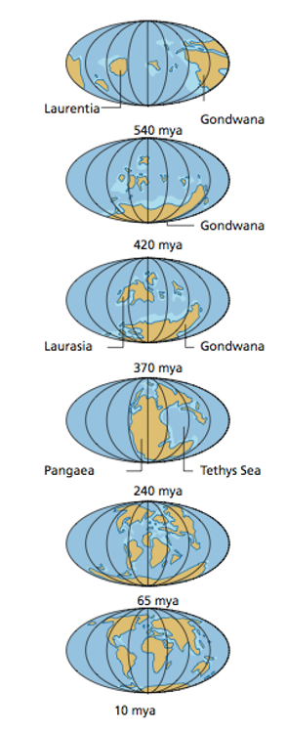
Topic Question 4: What is the geological time scale and what changes on Earth have occurred during this time?
Over geological time, several different continents have existed, including the southern content Gondwana and
the supercontinent Pangaea.

Slide 17
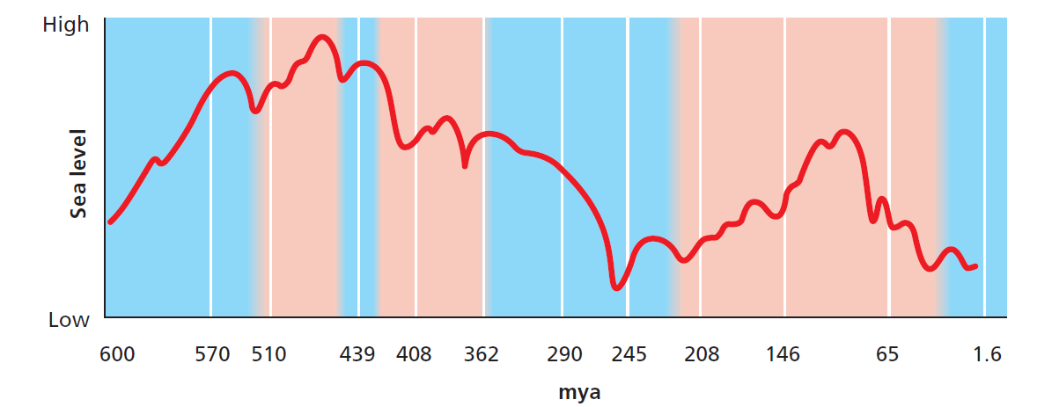
Topic Question 4: What is the geological time scale and what changes on Earth have occurred during this time?
Large climate oscillations have occurred on Earth over its history. These oscillations have occurred in Earth’s temperature, humidity and sea level.
Figure 6.4

Slide 18
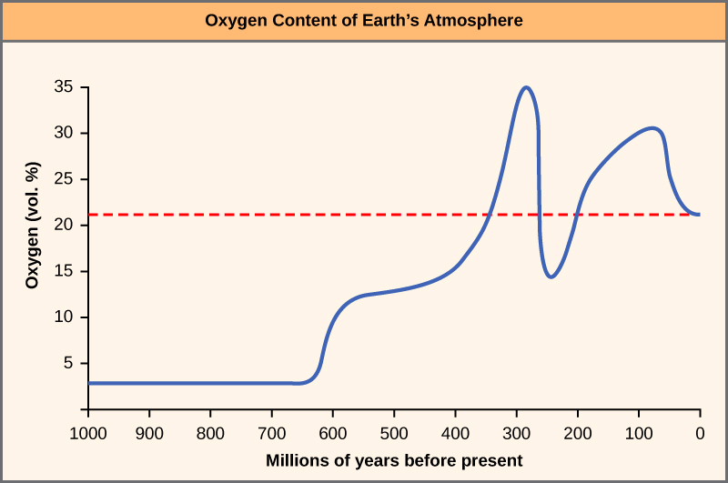
Topic Question 4: What is the geological time scale and what changes on Earth have occurred during this time?
The oxygen level of Earth’s atmosphere rose sharply around 300 mya.
The gradual increase in the atmospheric oxygen level corresponds with an increase in organisms’ body size in the fossil record.
This corresponds with the Carboniferous period and the rise of photosynthetic plants
http://cnx.org/content/m44660/latest/?collection=col11539/latest

Slide 19
Video Link and Australian Museum Web Link
https://www.youtube.com/watch?v=rWp5ZpJAIAE
https://australianmuseum.net.au/learn/australia-over-time/evolving-landscape/the-geological-time-scale/

Slide 20
Evidence for the theory of evolution includes: comparative genomics (molecular evidence), the fossil record, comparative anatomy and embryology
Technological developments in the fields of comparative genomics, comparative biochemistry and bioinformatics have enabled identification of further evidence for evolutionary relationships (SHE)
Evolutionary relationships between groups can be represented using phylogenetic trees

Slide 21
Syllabus
Evidence for the theory of evolution includes: comparative genomics (molecular evidence), the fossil record, comparative anatomy and embryology
Using examples describe the different types of evidence used to support the theory of evolution
Syllabus:
Essential
Question:

Slide 22
What you need to complete
BIOLOGY WA UNITS 3&4
READ
Chapter 8 Mechanisms of Evolution and Speciation
Questions
Set 8.4 pg.268 Q 1-7
BIOZONE
See slides for activity numbers

Slide 23
Topic Question 1: State the 5 lines of study that has provided the evidence to support the theory of evolution
Paleontology - the study of prehistoric life, particularly the fossil record
Biogeography - the study of the distribution of species over time
Developmental biology - the study of the process by which organs develop
Morphology - the study of the form and structure of organisms
Genetics - the study of genes, heredity and variation in living organisms

Slide 24
Topic Question 2: State the evidence used to support the theory of evolution
Fossil evidence
Comparative Anatomy
Comparative Embryology
Comparative genomics – the comparison of genomic features of organisms
Comparative biochemistry – the comparison of proteins of organisms
Bioinformatics – analysis of large data sets (such as the genomic sequences of different organisms)

Slide 25
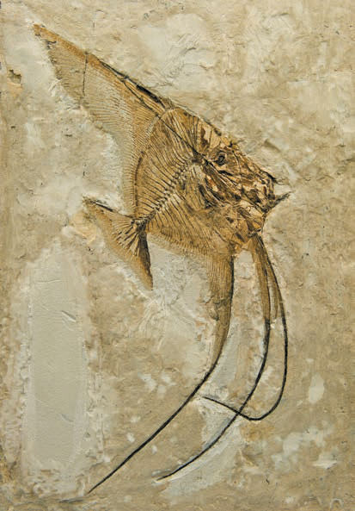
Topic Question 3: Define the term fossil
Fossils are the preserved remains and traces of past life
These remains can be hard parts, such as teeth, bones and shells, or impressions in the rock where the organism’s tissue has decayed, footprints.
Shutterstock.com/MarcelClemens

Slide 26
Topic Question 4: What evidence of evolution do fossils provide?
Show past life and extinct organisms
Show that life has changed in variety and has changed over time from simple to very complex organisms, and that life on Earth has a long history
Show how one type of organism has transitioned to another - transitional fossil
  There is an intermediate state between an organism’s ancestral form and that of its descendants, such as the famous bird/dinosaur transitional form Archaeopteryx. This provides evidence of how one group evolved from another

Slide 27
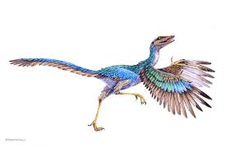
Topic Question 4: What evidence of evolution do fossils provide?
The Classic Fossil Example
The Archaeopteryx was a small flying dinosaur with feathers.
It appeared in the late Jurassic period.
It shared features in common with both birds and reptiles, suggesting that birds evolved from reptiles.
Its reptile-like features include a long-tail, claws, no keel, solid bones, and teeth.
Its bird-like features include a wish-bone, feathers and reduced fingers. Intermediate states such as Archaeopteryx are called transitional forms.
Alamy Stock Photo/Martin Shields

Slide 28
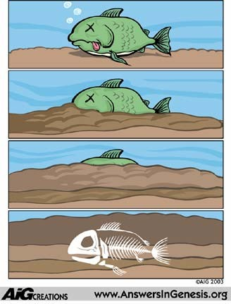
Topic Question 5: Describe how fossils are formed
Fossils form best when organisms are buried quickly in conditions that slow the process of decay.
Fossils are most commonly found in sedimentary rocks.
    Sedimentary rocks are the types of rocks formed by the deposition of mineral/organic particles at the Earth’s surface
Factors affecting fossil formation include:
    Type of organism – hard parts fossilise better than soft parts e.g. bone, teeth, shell
    Soil pH, mineral content of soil
    Weathering and erosion

Slide 29
Topic Question 5: Describe how fossils are formed
Organic matter quickly deposited and covered in sediments in an environment that lacks oxygen, preventing decomposition
Organisms covered with sedimentary materials (e.g. mud); materials consolidate to form sedimentary rock
Minerals from sediments replace the natural bone/shell material, hardening the fossil
Long period of time

Slide 30
Topic Question 6: what is the fossil record?
It is the history of life as documented by fossils, the remains or imprints of organisms from earlier geological periods preserved in sedimentary rock. (https://www.britannica.com/science/fossil-record)
The fossil record helps paleontologists, archaeologists, and geologists place important events and species in the appropriate geologic era.
It is based on the Law of Superposition which states that in undisturbed rock sequences the bottom layers are older than the top layers. (https://www.nationalgeographic.org/topics/resource-library-fossil-record/?q=&page=1&per_page=25)

Slide 31
Topic Question 6: what is the fossil record?
The principle of superposition indicates that the oldest rock layer is found at the bottom of the rock, with each consecutive layer above being relatively younger.

Slide 32
Topic Question 7: How are fossils dated?
Relative dating | Absolute dating
Used to determine the age of a rock, or a fossil contained in the rock, relative to other rocks or fossils found nearby | Assigns a numerical age in years to a fossil or rock
Strata are deposited in a time sequence, with the oldest on the bottom and the youngest on the top (principle of superposition). Palaeontologists can assign relative ages to fossils based on the strata in which they are found. | Three main types: radiometric dating, electron spin resonance and luminescence. Most common method of absolute dating is radiometric dating, which uses the known rates of decay of naturally occurring radioactive isotopes present in a rock or fossil.

Slide 33
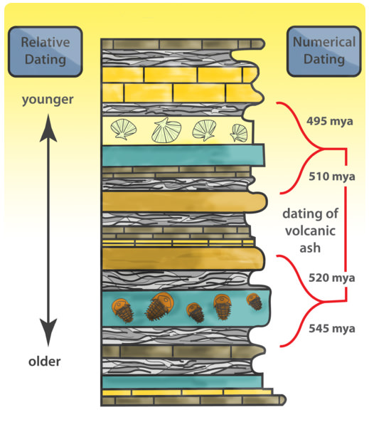
Topic Question 7: How are fossils dated?

Slide 34
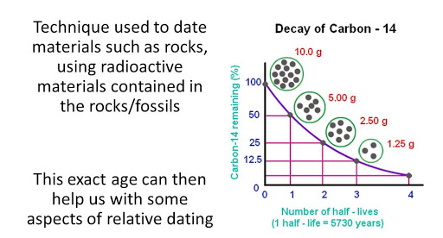
Topic Question 7: How are fossils dated?
  Absolute Dating – using radioactive elements and gives us a time frame. They can be used to time events.
    e.g. C14- bone,shell, charcoal. Up to 60 000years old

Slide 35
Topic Question 7: How are fossils dated?

Slide 36
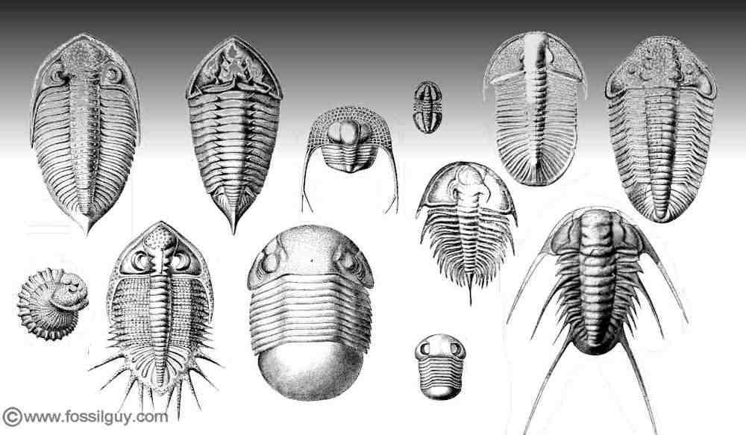
Topic Question 7: How are fossils dated?
  Index fossil is found in the rock layers of only one geological age and is used to establish the age of the rock layers.
    E.g. trilobites (genus = Paradoxides, refer to next slide) – rock layer 500-600 mya

Slide 37
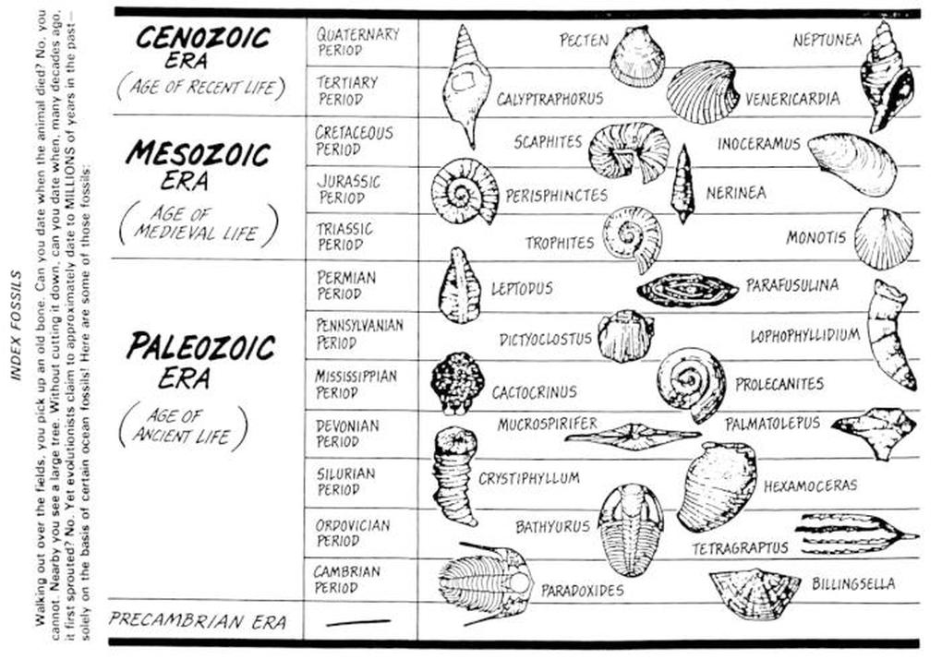
Fossil record

Slide 38
Topic Question 8: Explain why the fossil record is incomplete
Because the process of fossilisation requires very specific, and rare, conditions (rapid burial in sediment). The remains of the vast majority of long-extinct animals may never be found.
Only a very small percentage of organisms leave fossilised remains.
Soft parts of organisms are unlikely to form fossils
Organisms need to avoid being decomposition, scavengers and predators to form fossils
Many fossils are destroyed by natural processes such as weathering and erosion.

Slide 39
Topic Question 8: Explain why the fossil record is incomplete
Additionally not all fossils have been discovered and if fossils are discovered that have to be recognised as fossils
Consequently, the fossil record is incomplete and biased toward organisms that lend themselves more easily to the fossilisation process. Specifically organisms with hard parts.

